Slide 1
vNext Update
Apr 2022
vNext Team
Notes:
Pedro
Thanks…
I’m Pedro Barreto….

Slide 2
Agenda
- Reference Architecture Documentation Status Update - vNext Build Progress Update - vNext Foundation - details
Notes:
Pedro
This the agenda for our presentation today:
I’ll start with an update on the reference architecture documentation effort
Then I’ll update on the progress of the vNext build
Lastly, I’ll go trhough some of the details of the vNext Foundation and how some important componentes work

Slide 3
Fixes and improvements
Ref. Architecture Documentation
Notes:
Last PI we released the Reference Architecture Documentation, and since then we’ve been working on fixes and improvements.

Slide 4
Ref. Architecture Doc - Status
Released Initial Version during PI 16
Ongoing Review Process Almost Complete
5 task in review – 3 blocked – 1 in progress - 2 in the backlog
https://docs.mojaloop.io/reference-architecture-doc/
Notes:
Michael has been working hard on the review and fix process. He has replaced most diagrams with better quality snapshots and also fixed the tens of issues we identified after PI 17.
He’s likely chasing key people for reviews and feedback, so, if your one of them please reach out.

Slide 5
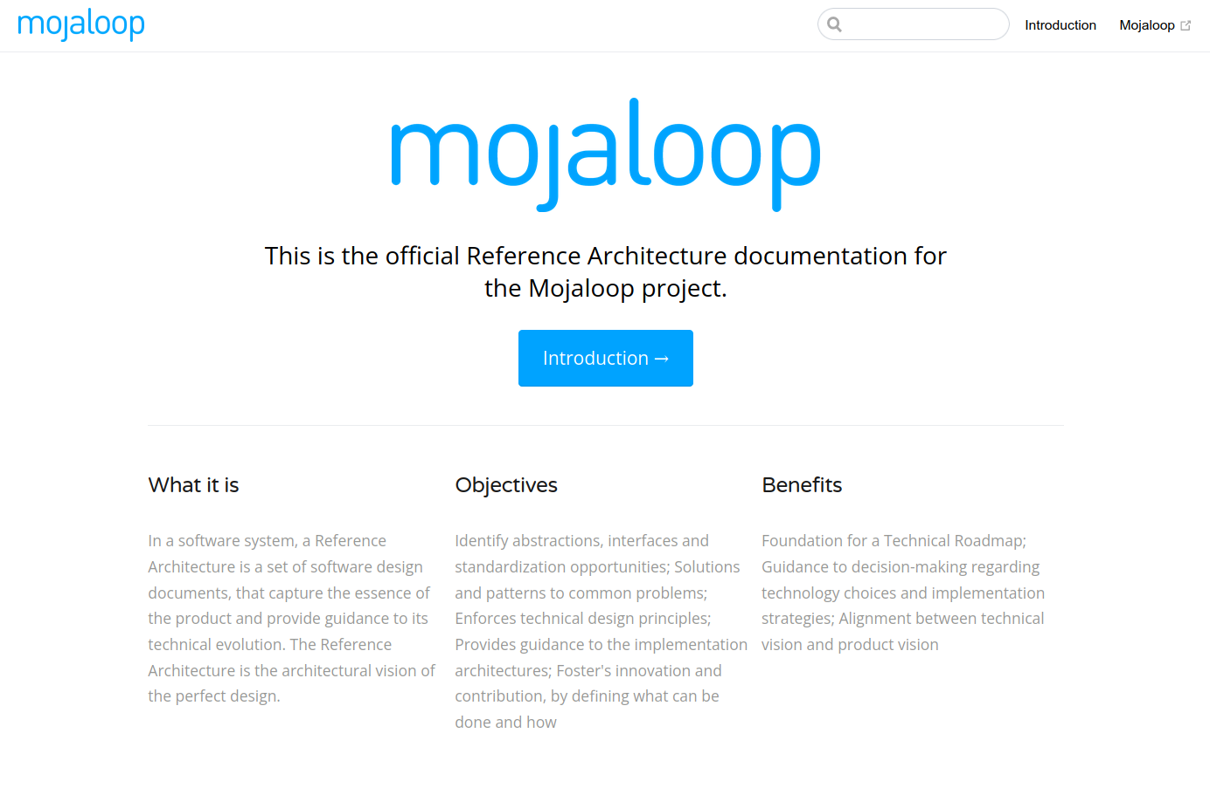
Notes:
This is what is looks like

Slide 6
Progress Update
vNext Build
Notes:
Ok, on to the vNext Build progress update
For those who don’t know, the vNext Build initiative is the programming of the future mojaloop generation, which incorporates the learnings and design of the Reference Architecture exercise.

Slide 7
vNext – What is the Alpha Release
Internal release for developers
Stable interfaces
Happy path only
Fully testable
Requires load tests, but no optimisation
Notes:
Before going into the actual status update, let’s recap what this alpha release is about… apologies to some of you who may have heard this already ☺
As you know, the reference architecture we created a few PI’s back is significantly different from the current version’s design, and requires a few important structural changes.
It is also an opportunity to enhance the technical foundation of the platform. This alpha release is mostly about these hard structural changes.
Once we have this technical foundation, we’ll add the most important features the current version has, targeting only the happy path.
So…
We want it to have enough functionality, so it is relevant for a comparison;
Must be fully testable and should proov the scalability of the design, leaving optimizations for later;
And its components need to have stable interfaces, so other developers can start contributing as soon as possible, without fear of refactors.
This Alpha release is essentially targeted to developers, our objective is to get done with the hard changes as soon as possible, so anyone interested in contributing, can do so on top of this new modern foundation.
The expectation is that once we release this alpha version, we’ll have contributors migrating existing code and integrations to this vNext version

Slide 8
vNext - Alpha Release
Design
Build of the foundation & Cross Cutting Concerns
Happy Path Features
<- We’re finishing this part!
Notes:
This alpha release work had three phases:
A design phase, where we designed the structure of the implementation in accordance to the reference architecture – a significant part of this wasdone already during the reference architecture sessions.
The building of the foundation and the cross cutting concerns
This includes activities such as the setup of repositories, preparing the infrastructure and the CI/CD pipelines.
The build of the cross-cutting concerns, this is the stage we currently finishing.
Next we’ll start working on the happy path code for the main use cases. That’s transfers, accounts and balances, participant lifecycle management, quotes, the interop API, etc.

Slide 9
vNext Build - PI 17 Objective
Deliver alpha version of the
cross-cutting concerns
(objective revised at PI16 convening due to lack of resources)
Notes:
As previously noted, due to the lack of resources dedicated to vNext build, we had to revise our objectives during our last convening.
Our objectives are to deliver the cross-cutting concerns during the month of May.

Slide 10
vNext Build - Status
 | Component Type | Repo name | Repo sub-dir / module
Done | Client - Shared Lib | platform-configuration-bc | config-client-lib
Done | Client - Shared Lib | platform-configuration-bc | secret-client-lib
Done | Service | platform-configuration-bc | config-svc
WIP | Service | platform-configuration-bc | secret-svc
Done | Client - Shared Lib | auditing-bc | auditing-client-lib
Done | Service | auditing-bc | auditing-svc
Done | Client - Shared Lib | logging-bc | logging-client-lib
Done | Service | logging-bc | logging-svc
Done | Client - Shared Lib | security-bc | authn-client-lib
Done | Service | security-bc | authn-svc
WIP | Client - Shared Lib | security-bc | authz-client-lib
WIP | Service | security-bc | authz-svc
 | Service | security-bc | kms-svc
WIP | Service | scheduling-bc | scheduling-svc
WIP | Service | scheduling-bc | scheduling-cliente-lib
 | Service | reporting-bc | reporting-svc
 | Client - Shared Lib | platform-monitoring-bc | metrics-client-lib
Done | Client - Shared Lib | platform-shared-lib | nodejs-kafka-client-lib
Done | Client - Shared Lib | platform-shared-lib | messaging-types-lib
Done | Service Template | nodejs-template-bc | n/a
Notes:
Where are we against those objectives...
We’re progressing, slower than expected due to lack of resources but still progressing.
For those that recall the mid-PI meeting, this is looking greener than before.

Slide 11
How does it work?
vNext Foundation
Notes:
The rest of this presentation will be about some of the things vNext does differently, or, are just new

Slide 12
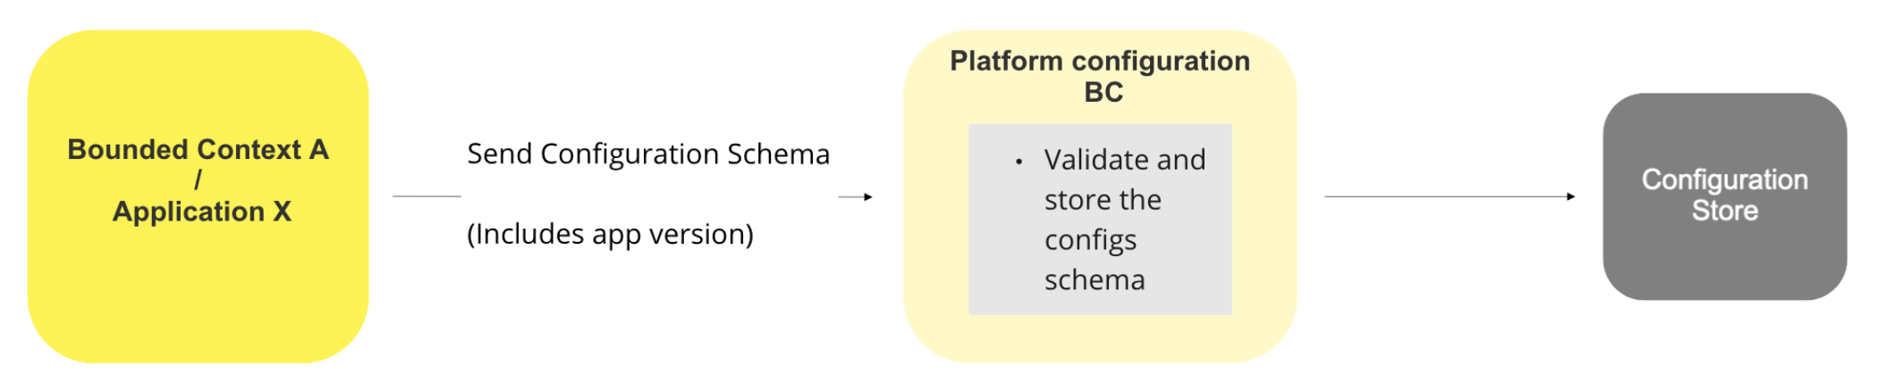
vNext Platform Configuration
Bootstrap
Configs can be:
Parameters
Feature Flags
Secrets
Notes:
Platform configuration – this is essencially central configuration management for the while mojaloop platform
Each application will register what it needs to run, and a central mechanism allows authoried operators to see the operational values and make changes.
Introduce what bootstrap is
This slide is about the bootstrap step... When a new version of a mojallop app or servisse is released.... It send to the central servisse a schema, that identifies all the configurables the application needs.
This schema includes configuration descriptions and defaults, and configurable items can be parameters, feature flags and secrets
Once this schema is received, the central platform configuration is able to expose the configurables for na operator to adjust via a nice UI or directly trhough the API...

Slide 13
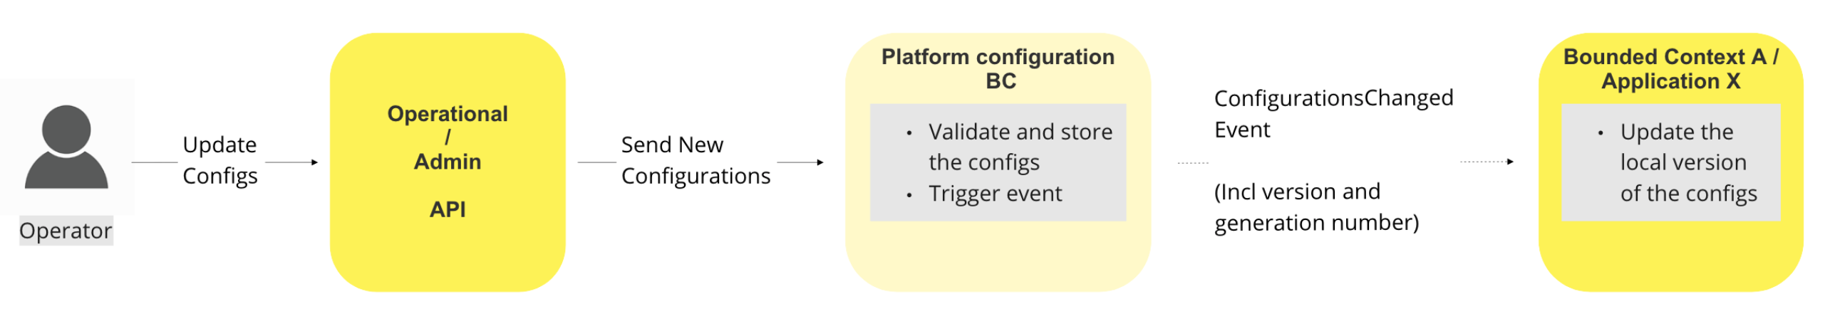
vNext Platform Configuration
Operator Changes
Notes:
In this slide we see what happens once na operator makes a change to a configuration value, we can assume that the operator is using a UI, which in turn calls the admin API.
When configurations change, an event is published, so interested applications can apply the new configuration.
Each configuration change, triggers na generation number, that is monotonic and can be used to track changes

Slide 14
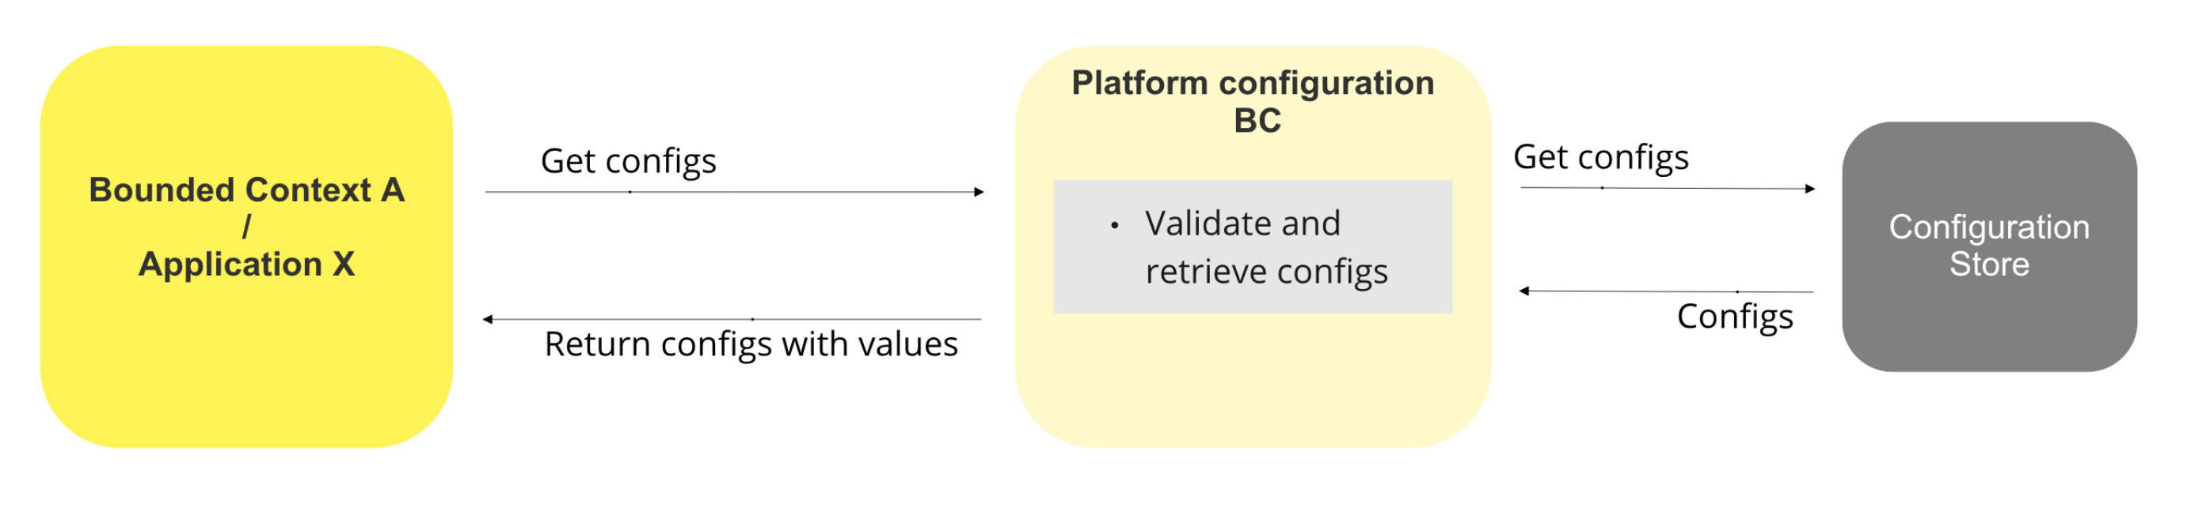
vNext Platform Configuration
Application Start
Notes:
This is the magic that happens when the application starts or restarts, it requests the platform configuration servisse for the current configuration values, and applies them at start.
At this moment the application is ready to work.
This mechanism, allows’ operators to no only have a single place for all configuration changes, but also a place to see all current and past configurations.
It is also for developers, who can easily build new applications and modules, by using these services and cliente libraries.

Slide 15
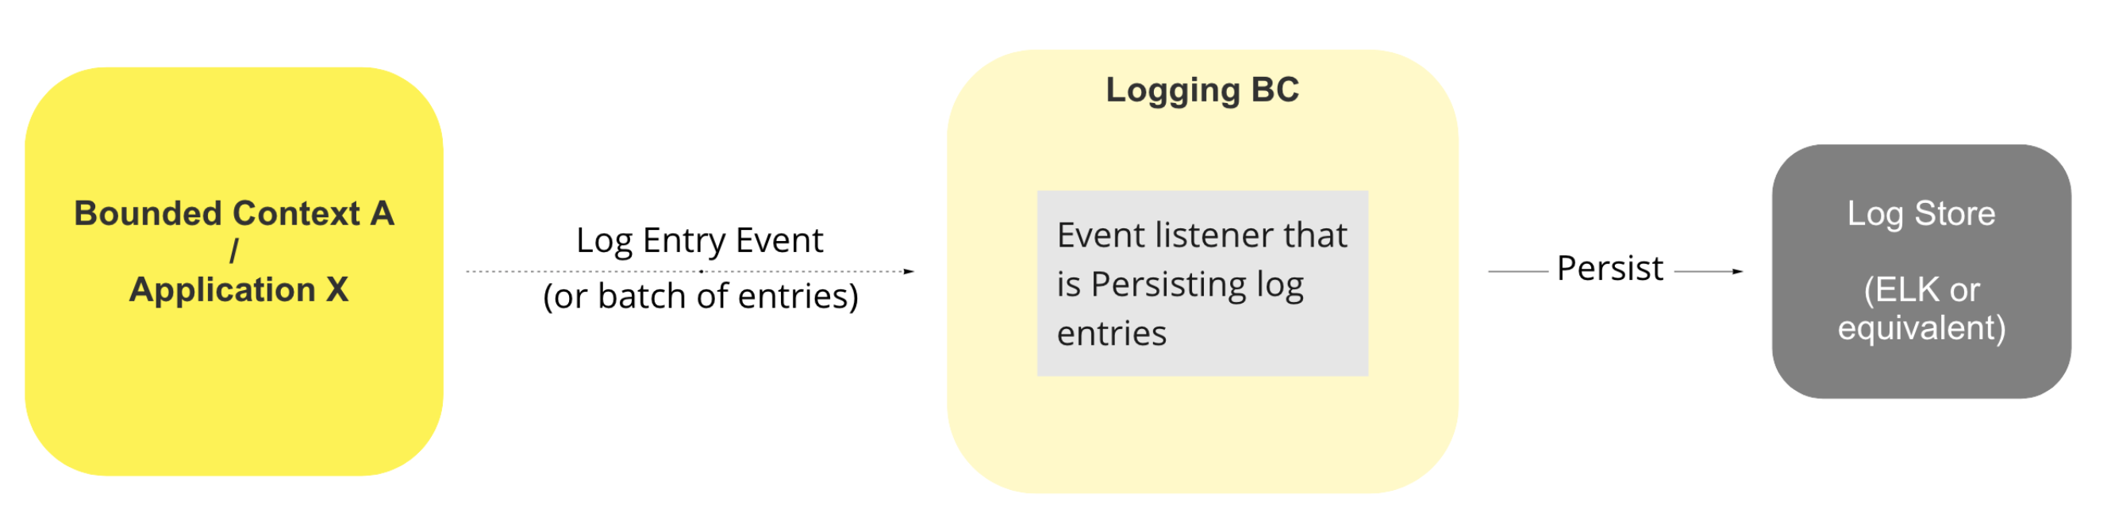
vNext Logging
Event or RPC based logging
Notes:
I have to start by explaining what logging is: Logging captures the details of how something happened, not the what, but the how… For example a certain method was executed. Usually logs are only interesting for programmers and system operators
Explain process
Logging from the application can be async event based or sync RPC style
An operator will be able to consult the logs directly or via a UI tool like we use today, such as kibana

Slide 16
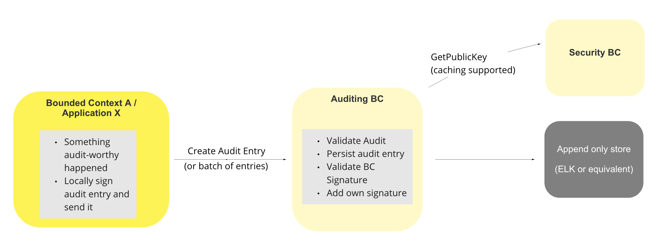
vNext Auditing
Event or RPC based auditing
Notes:
Auditing is different, auditing is about who did what and when. It’s useful to auditors or anyone interested in knowing domain facts or events, such as that a transaction happened or a participant change was approved.
These are somehow similarities with the implementation of the logs, but they offer completely different security options on the storage side.
In auditing’s case, the system has write only access to the audit store.
Explain process
Like the logging, auditing from the application can be async event based or sync RPC style
Not shown here is the startup step for the application, where it gets its own private key for the local audit signing

Slide 17
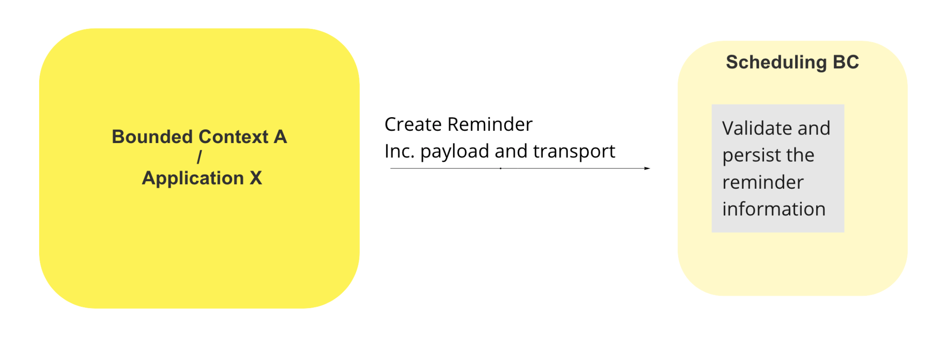
vNext Scheduling
Create reminder
Notes:
Another facility that vNext has, is that it allows applications to register time based reminders centrally. One shot or recuring.
This can be though of a resilient, platform wide cron… other services can request a specific event to be sent, or a url to be called, at specific times or intervals.
The objective is to avoid other parts of the switch to have to implement this not so easy functionality.
A few examples where this will be helpful:
Processes that must be executed at a certain time of day/week/month, like settlements that run at night, a weekly report generation.
Notifications of elapsed time for timeouts that are longer than a few seconds and need the extra resilience.
This diagram show the create reminder use case.

Slide 18
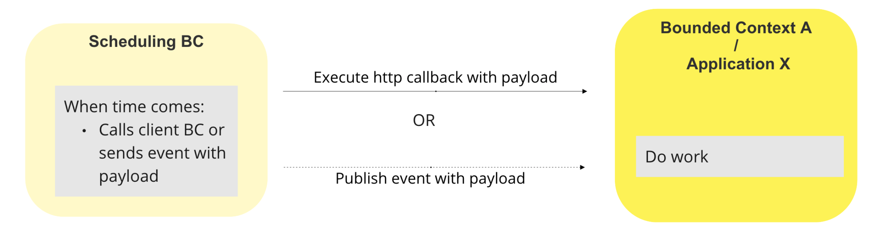
vNext Scheduling
Trigger reminder
Notes:
Some time in the future, when the time comes, the scheduling BC servisse will do as intructed, and either send an http request to the requested url, or send an event to a certain topic, which the original application is expecting and knows what to do.

Slide 19
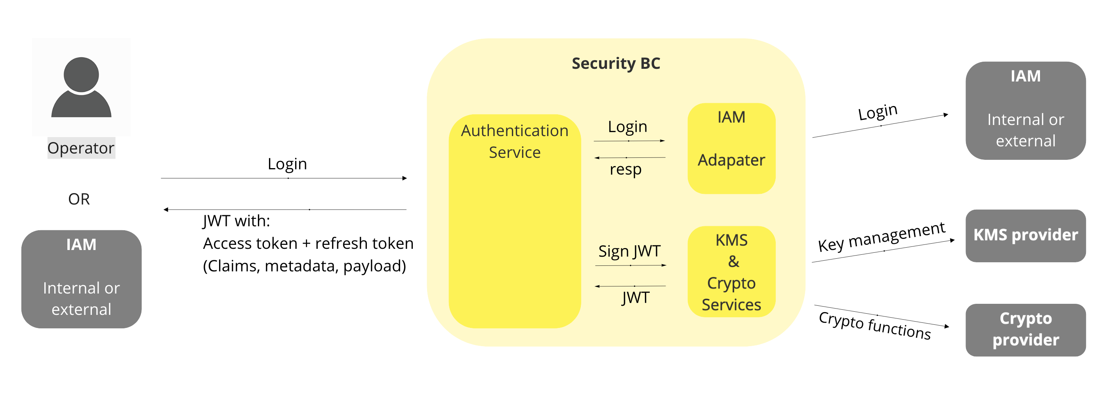
vNext Security - Authentication
Notes:
Explain process
Explain internal or external IAM, KMS and Crypto
Access token + refresh token; The access token includes claims/roles, other metadata like userId, and a custom payload
Unfortuntatly the Authorization process is a too complex to fit a slide of two, if anyone is interested, I can show the diagrams and walk through them.

Slide 20
We really need help!!
We STILL need developers willing to work on this effort
Notes:
As usual, my thanks to the team: Michael Wagener who’s been helping with the documentation, and also Jason Bruwer and Gonçalo Garcia on the vNext build.
So… we end with the same ask..
This is not going as fast as we’d like, so if you’re interested in helping, please reach out.

Slide 21
Questions?

Slide 22
Reading / References?
Official Ref Arch Doc Page: here
Ref Arch Working Doc: here
Ref Arch Miro Board: here
Next version build plan working doc: here
PI-13 Jan 21 - Mojaloop Performance, Scalability and Architecture Update: here
PI-14 Apr 2021 - Opening and Mojaloop Reference Architecture and TigerBeetle: here
PI-15 July 2021 - Reference Architecture v1.0: here, videos
PI-16 Oct 2021 - Reference Architecture and V2 update: here, videos

